Slide 1
Squiggles Design Portfolio
Here is where your presentation begins

Slide 2
Contents of this template
You can delete this slide when you’re done editing the presentation
Fonts | To view this template correctly in PowerPoint, download and install the fonts we used
Used and alternative resources | An assortment of graphic resources that are suitable for use in this presentation
Thanks slide | You must keep it so that proper credits for our design are given
Colors | All the colors used in this presentation
Icons and infographic resources | These can be used in the template, and their size and color can be edited
Editable presentation theme | You can edit the master slides easily. For more info, click here
For more info:
Slidesgo | Blog | FAQs
You can visit our sister projects:
Freepik | Flaticon | Storyset | Wepik | Videvo

Slide 3
Table of contents
01
02
03
04
Introduction
Resume
My work
Previous projects

Slide 4
Contents of a portfolio
A portfolio is composed of three main elements:
Content - this includes the actual work you want to showcase and can be anything from writing samples to photographs or videos
Design - the design should reflect your personality and style while remaining professional. It should also make it easy to navigate the portfolio
Summary - a brief summary at the beginning of the portfolio will help provide an introduction to your work and give visitors a better understanding of yourself and what you have created

Slide 5
You should include in your portfolio…
Work samples
Skills
Narrative
Work samples can be anything from graphics to writing, videos or websites that showcase your design, development or the writing skills you have
Skills and qualifications are the credentials you have that show employers your experience and abilities in various areas related to your field
An overview of past project or other accomplishments as well as a summary of relevant knowledge and skills gained over the course of your career

Slide 6
02
Resume

Slide 7
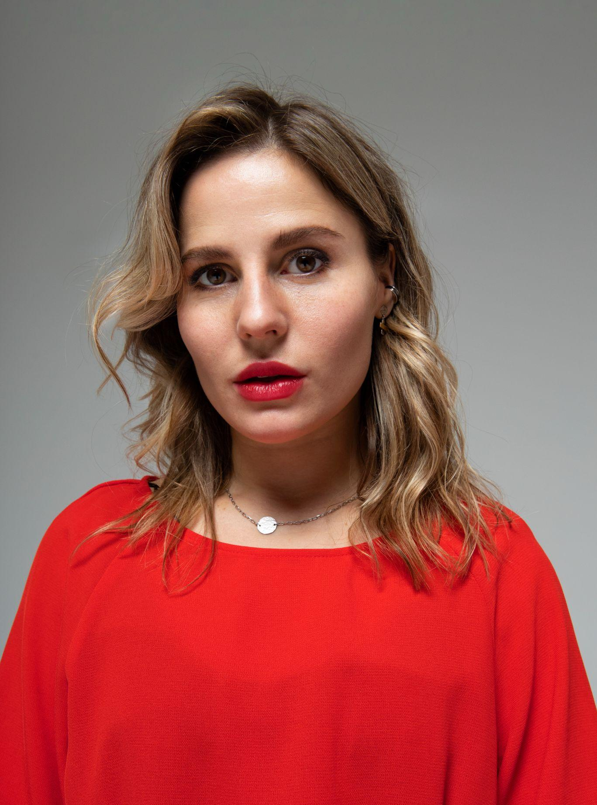
Jane Doe
+34 654 321 432 | jane@freepik.com
“I always strive for excellence. I believe in the power of collaboration, and I love to build meaningful relationships with clients throughout the creative process”
Education
Experience
20XX- 20XX
Communication
Writing
Leadership
20XX- 20XX
Marketing technician
Marketing agency
Marketing degree
Tracking and analyzing data to optimize campaigns
Coordinating promotional activities
20XX- 20XX
Graphic Design
Creativity
Curiosity
20XX- 20XX
Content creator
Creation Studio
Graphic design master
Creating videos, podcasts, graphics and infographics
Developing unique and engaging content
20XX- 20XX
Creativity
Adaptability
Management
20XX- 20XX
Team leader
Creation Studio
Content master
Motivating and leading team members in tasks
Setting clear objectives and goals for the team

Slide 8
Previous projects
Marketing
“I was responsible for managing campaigns across all major social media platforms; creating, curating and optimizing content for maximum engagement; analyzing data to gain insights into customer behavior and maintaining a strong relationship with customers”
Content creation projects
“I have participated throughout my career in crafting seo-friendly copy, creating promotional videos, designing newsletters and brochures and more. My work has been well received with several pieces being featured in prominent and important, widely-read publications”

Slide 9
Cover letter
Freepik
+91 620 421 838
jane@freepik.com
Welcome to my portfolio!
I'm [name], a highly creative and motivated individual, with a passion for [field of expertise]. My portfolio is filled with unique and inspiring content, which showcases my skills in the field.
Here you will find everything ranging from writing samples, photographs, videos and more. I strive for excellence in all that i do, and this portfolio serves as a testament to my capabilities and accomplishments.
Have a look around, get to know me better, and don't hesitate to reach out if you have any questions or would like to collaborate!
Sincerely,
Jane Doe
+91 620 421 838 | jane@freepik.com

Slide 10
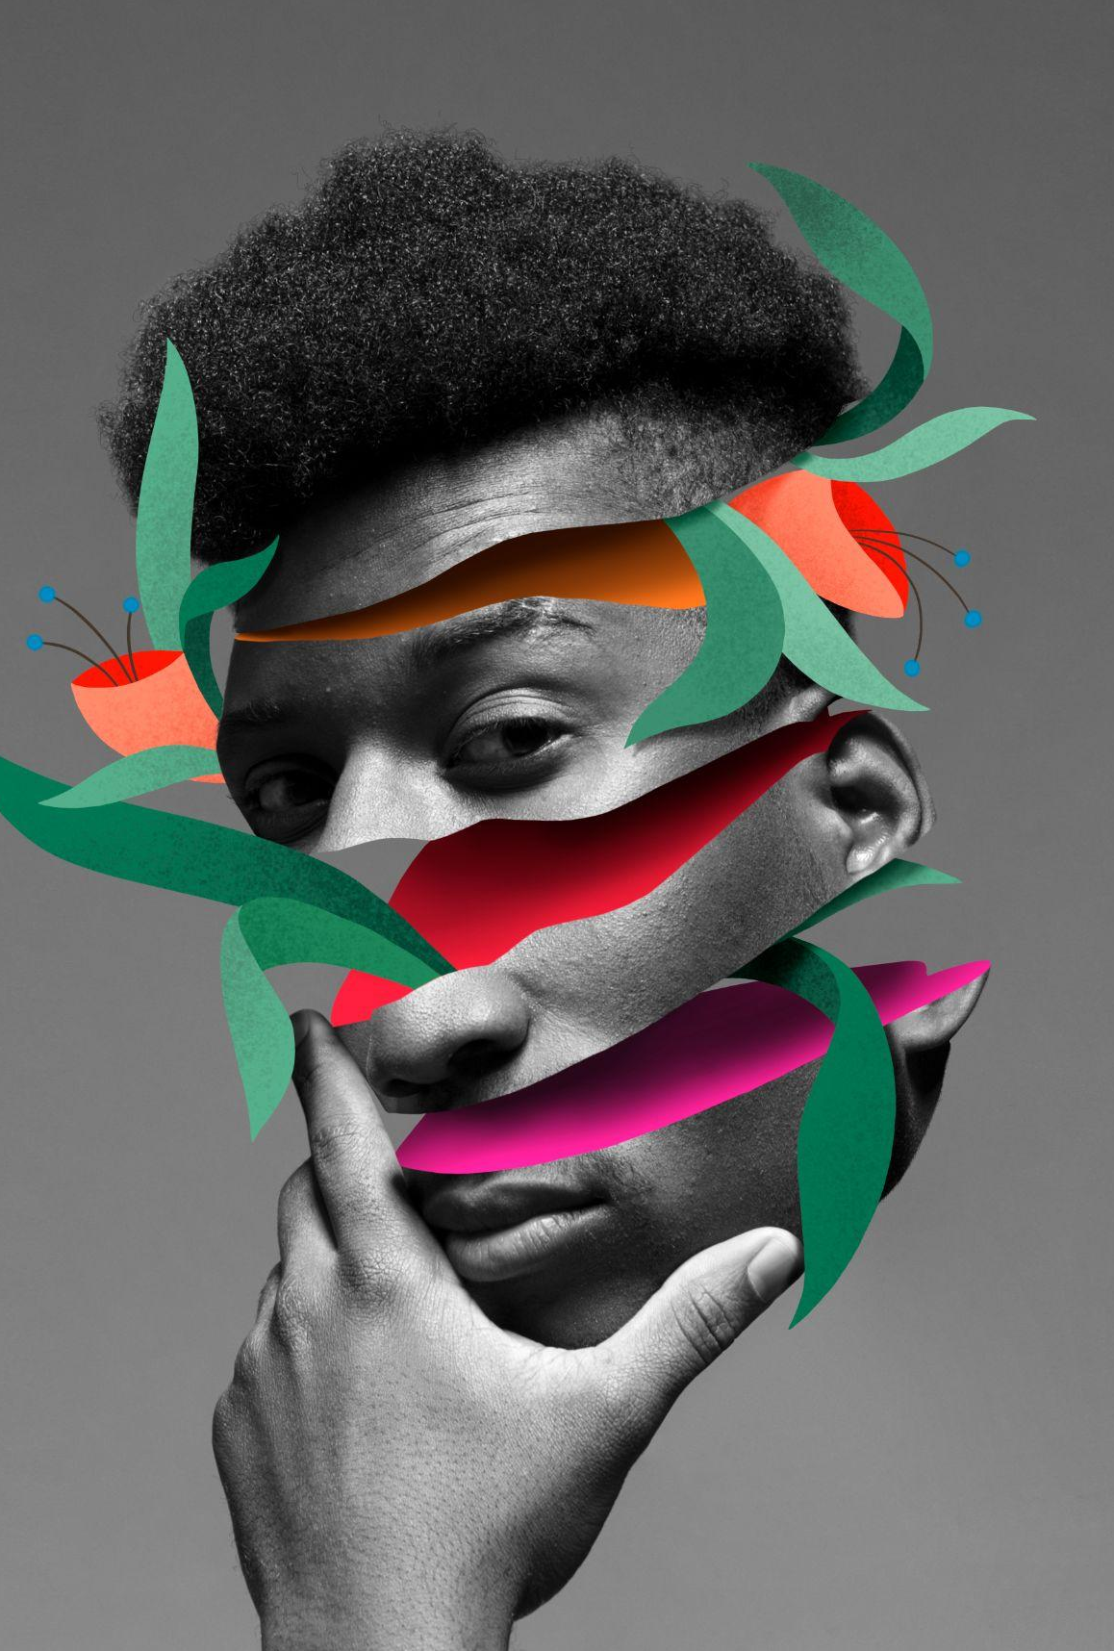

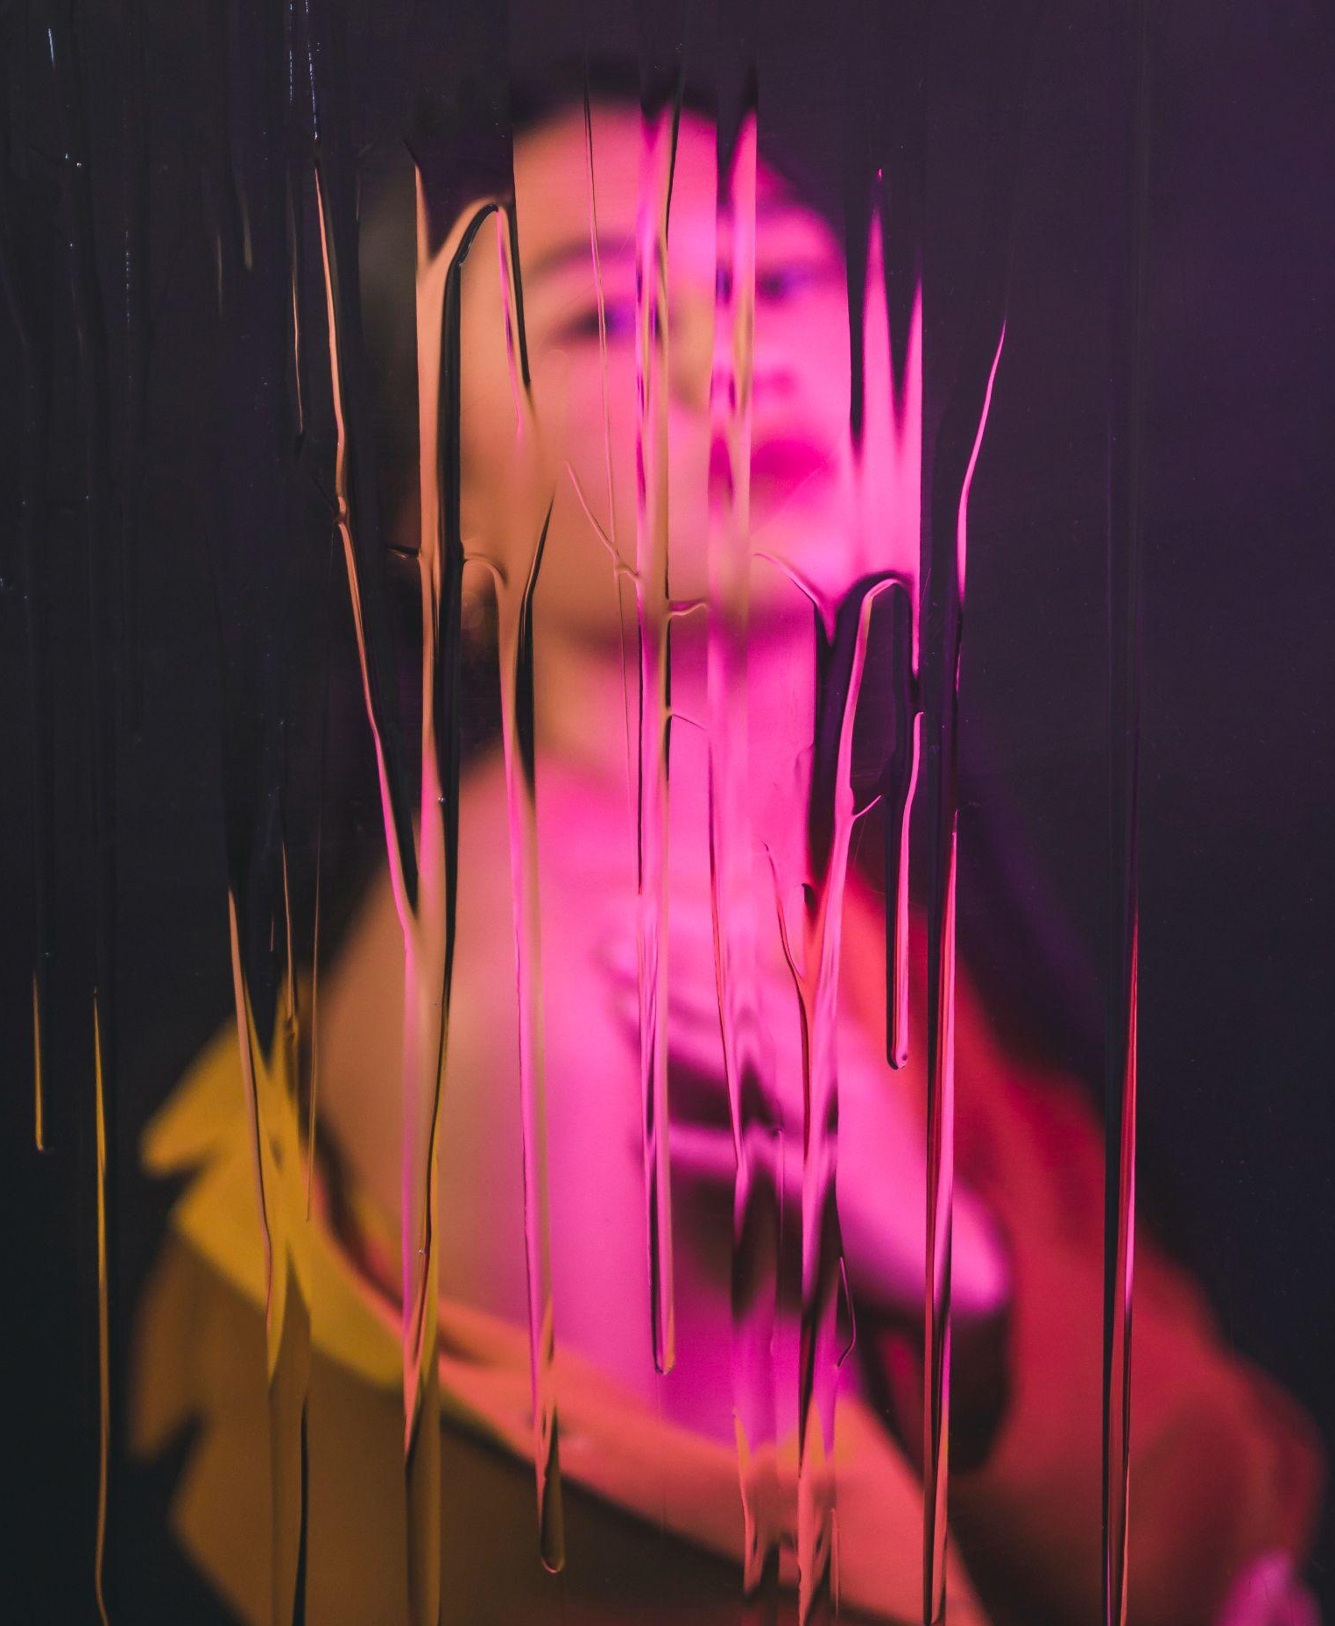
My best work
“As an artist, it's my job to capture the beauty, joy and emotion of the world around me. I strive to create something unique in each piece, combining technique and detail”

Slide 11
What people say about me
Employer 1
Employer 2
“I have been impressed by the quality, attention to detail and creative approach brought to every project”
“Projects and campaigns are always taken to another level with ideas that come from this person. Digital marketing and content creation experience is quite evident”
Employer 3
Employer 4
“This person has a strong technical understanding in order to develop successful marketing strategies. Highly recommended for any kind of project”
“Content creation is top-notch, with engaging yet professional writing style tailored to different audiences while keeping a steady brand message”

Slide 12
My skills and qualifications
Leadership
Problem-solving
Communications
“I possess leadership abilities that have been sharpened through past roles where I was responsible for the teams”
“My problem-solving capabilities have enabled me to solve difficult issues in the past, using lot of creative solutions”
“With excellent verbal and written skills, I can effectively convey complex messages to a variety of audiences”
Organization
Technical skill
Interpersonal skill
“My proactivity allows me to plan ahead and prioritize tasks according to objectives and different deadlines”
“I am knowledgeable in several technical areas such as programming languages which support my ambitions in my field”
“Teamwork is one of the essential part of my daily job, and i am sensitive towards different cultures”

Slide 13
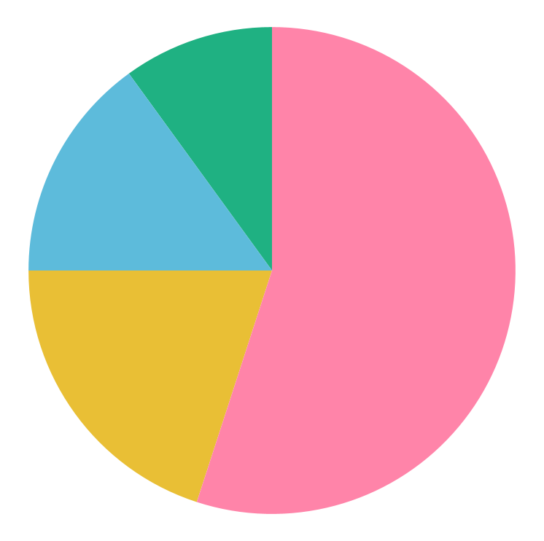
A chart of the areas I work in
55%
20%
15%
10%
Social media
Instagram, Twitter
Marketing
Promotion
Graphic design
Illustrations, vectors
Copywriting
SEO copywriting
Follow the link in the graph to modify its data and then paste the new one here. For more info, click here

Slide 14
Table
Project Title | Skills | Date | Ref | Category
Project 1 | Graphic design | Jan 20XX | [Link or reference] | Print
Project 2 | Copywriting | Feb 20XX | [Link or reference] | Content
Project 3 | Video production | Mar 20XX | [Link or reference] | Motion
Project 4 | 3D modeling | Apr 20XX | [Link or reference] | 3D
Project 5 | UI/UX design | May 20XX | [Link or reference] | Web
Project 6 | HTML/CSS | Jun 20XX | [Link or reference] | Web

Slide 15
How did I achieve success?
Step 1
Step 5
Analyzing outcomes
Research and preparation
Step 2
Step 6
Identifying objectives
Developing strategies
Step 3
Step 7
Measuring progress
Plans of action
Step 4
Step 8
Continuous improvement
Focusing on the future

Slide 16
Roadmap of my future projects
Initiative | Objective | Jan | Feb | Mar | Apr | May | Jun | Jul | Aug | Sep | Oct | Nov | Dec
Developing a digital strategy | Reach potential customers through well-crafted campaigns
Creating engaging content | Craft content that engages and inspires the target audience
Optimizing search in rankings | Optimize for better and more visibility with SEO
Leveraging social media platforms | Connect with customers and boost brand awareness
Analyzing user digital habits | Gather user data to optimize design for more engagement
Executing email & web campaigns | Send emails to subscribers to convert leads into sales
Venus
Mars
Jupiter
Saturn
Neptune
Earth

Slide 17
Thanks!
Do you have any questions?
youremail@freepik.com
+34 654 321 432
yourwebsite.com
Please keep this slide for attribution

